Slide 1
RAD Live Q&A
Post-Closing Completion Certification
RAD Minority Concentration Analysis Tool
November 9, 2017

Slide 2
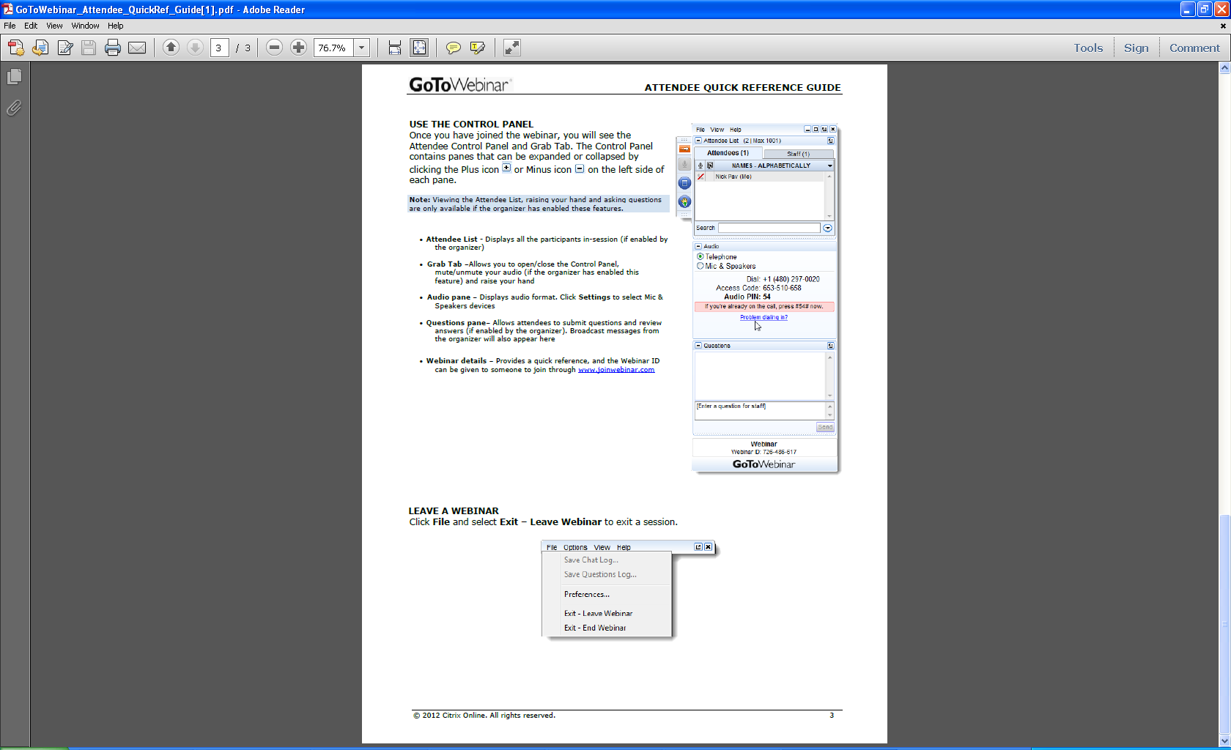
Welcome
Ask questions at the end! Here’s how:
  “Raise your hand” by clicking on the
  hand icon and the presenter will
  un-mute your line so you can ask
  your question live
  Note: To do this, you MUST call the dial-in number shown on your attendee control panel and input the audio PIN shown, which is unique to each attendee
  Send in questions via the “Question” feature or email them to rad@hud.gov; answers to those questions will be provided after the webcast and posted to the FAQs

Slide 3
Agenda
Post-Closing Completion Certification
RAD Minority Concentration Analysis Tool
Q&A

Slide 4
Post-Closing Completion Certification
RAD Notice requires owners to submit a “completion certification” documenting compliance with requirements of the RAD Conversion Commitment (RCC)
We have developed a page on the Resource Desk for Owners to enter information for key information related to:
  Construction completion
  Right of Return
  Section 3
We have also posted instructions on how to complete each field

Slide 5
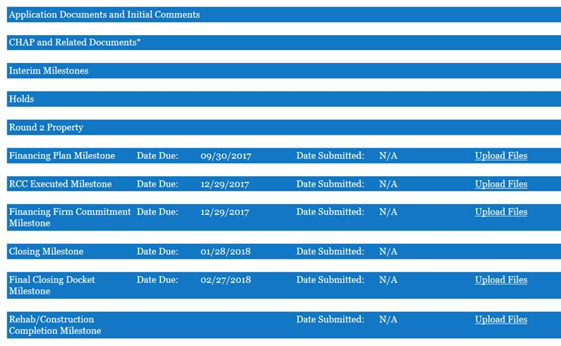
Completion Certification on the Resource Desk

Slide 6
RAD Minority Concentration Analysis Tool
HUD conducts and upfront civil rights review whenever a RAD conversion involves new construction
  Is area minority concentrated?
  If area is minority concentrated, does it meet one of the exceptions?
RAD Minority Concentration Analysis allow PHAs to quickly assess whether a proposed site for new construction under RAD is or may be in an area of minority concentration
See RAD Fair Housing, Civil Rights, and relocation Notice (Housing/PIH 2016-17)

Slide 7
Site and Neighborhood Standards Decision Tree
Does PHA identify the site as being minority concentrated?
No
Yes
PHA completes RAD Minority Concentration Analysis Tool
Submit justification for why the site meets one of the exceptions for new construction in an area of minority concentration
Tool shows site is not minority concentrated based on both census tracts and census tract plus adjacent census tracts
Tool shows that site is not minority concentrated based on either census or an alternative geography
Tool shows that census tract, census tract plus adjacent census tracts, or alternative geography is minority concentrated
HUD confirms site is not in an area of minority concentration
HUD reviews census tract or alternative geography

Slide 8
Live Q&A
Ask questions! Here’s how:
  “Raise your hand” by clicking on the
  hand icon and the presenter will
  un-mute your line so you can ask
  your question live
  Note: To do this, you MUST call the dial-in number shown on your attendee control panel and input the audio PIN shown, which is unique to each attendee
  Send in questions via the “Question” feature or email them to rad@hud.gov; answers to those questions will be provided after the webcast and posted to the FAQs

